Slide 1
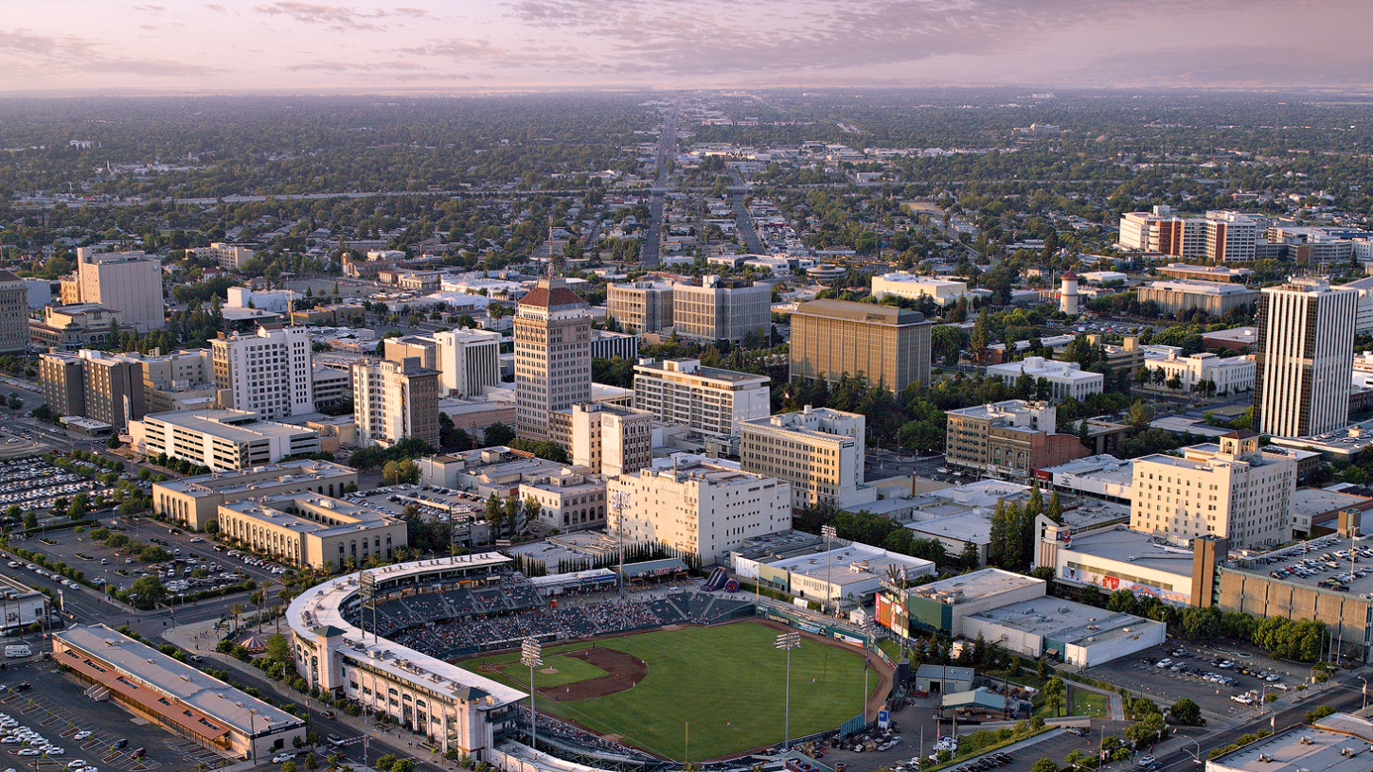
CITY OF FRESNO’S RESPONSE TO COVID

Slide 2
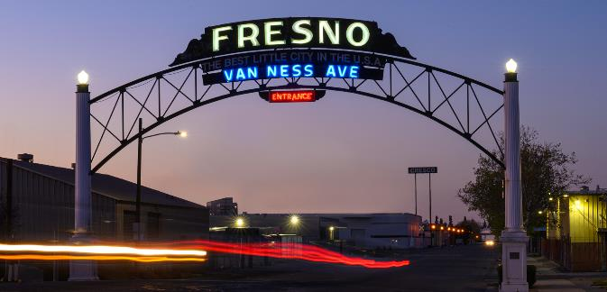
COVID Response
Overview
City Demographics Overview
COVID Guidance
Partners
Mitigation Measures
Safety Protocols
Impacts of COVID
Mandatory Testing
What’s next

Slide 3
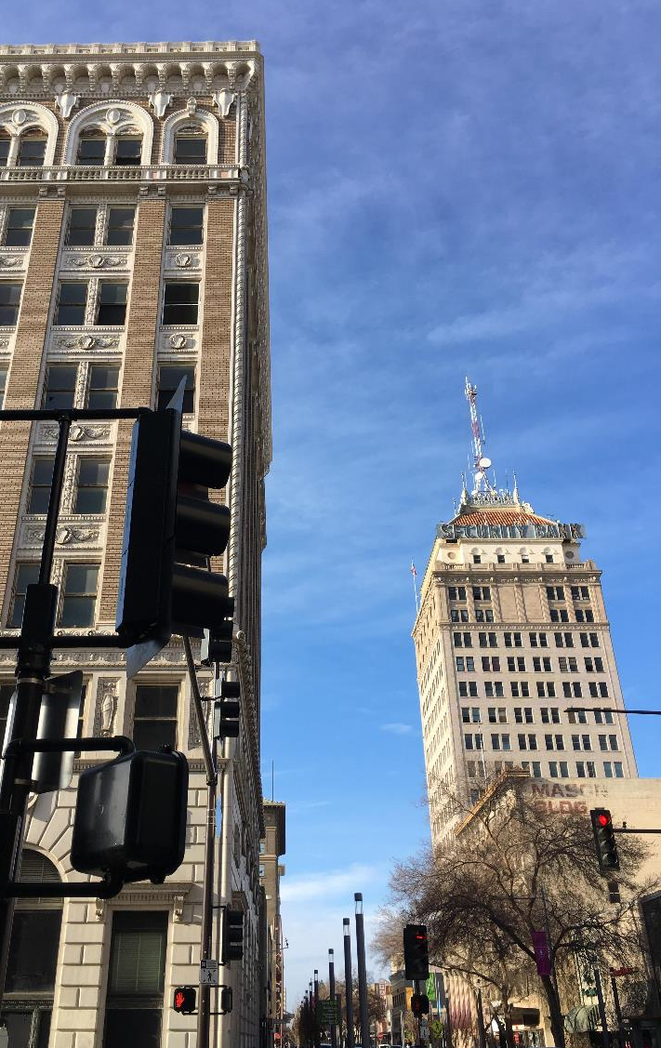
OUR DEMOGRAPHICS
Strong Mayor Form of Government with elected City Council of 7 District Representatives
5th largest City in California (pop 542,107)
County of Fresno has 1,042,157 population
with only 54% vaccinated with at least one shot
Over 4,400 employees
2,284 have not confirmed vaccination status and are now subject to testing
Of those, over 200 are Bus Drivers out of the 297 total.

Slide 4
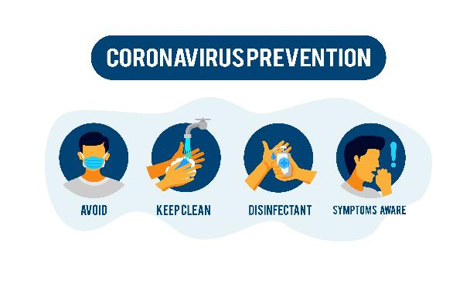
Review of Emergency Orders for Guidance
Fresno County Department of Public Health (FCDPH)
California Department of Public Health
Federal Centers for Disease Control (CDC)

Slide 5
Identify Key Partners
City Administration
County Department of Public Health
California Department of Public Health
Labor Unions
COVID19 Emergency Operations Center
Healthy Workforce Task Force Team

Slide 6
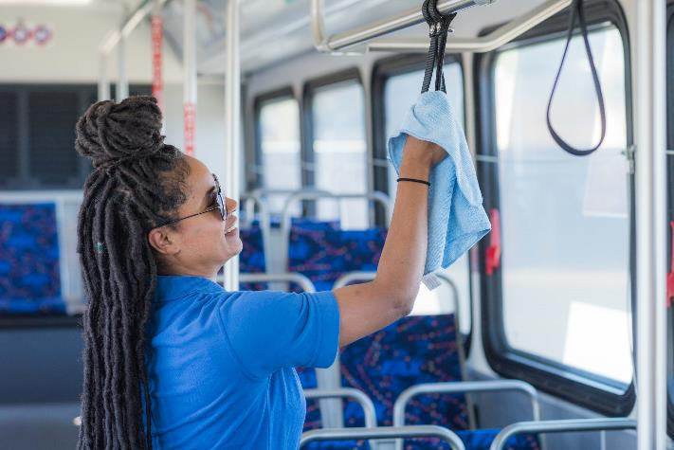
COVID-19 Mitigation Measures
Public Meetings are closed to the public held via Zoom
Limiting large scale events and mass gatherings
Mask required to be worn inside city buildings
Health screening for all employees and visitors to city facilities
Cleaning, disinfecting, practicing good hygiene daily, and deep disinfecting over the weekends in all buildings

Slide 7
Impact of COVID on the City
RISK DETERMINATIONS
3,370 Contracting Tracing Assessments On Employees conducted
CASES
560 COVID+ Cases of Employees
DEATHS
3 Employees have died
due to COVID
Effects of COVID on
City of Fresno Employees

Slide 8
Mandatory Testing of City Employees
By Emergency Order 2021-01 weekly testing for over 2,200 employees who have not shared vaccination status
Testing conducted at 20
pop-up sites a various city facilities using UCSF Medical Staff
Beginning September 20^{th,} mandatory testing for all employees whose vaccination status is unverified by Personnel
Monthly cost to city is about $150,000

Slide 9
What’s Next?
Effects on Employees
Moral Issues
Loss of Great talent who may
be hesitant
Brain Drain
Productivity
Vaccinations
Should they be Mandatory or Not?

Slide 10
Contact Information
Gregory A. Barfield
Assistant City Manager
City of Fresno
559 621-7784
Gregory.Barfield@fresno.gov
Fresno.gov

